Slide 1


Green Pace
Security Policy Presentation
Developer: Tyler Pease
The following presentation outlines the best coding standards and different methods the company can take to keep itself secure from attacks.

Slide 2

OVERVIEW: DEFENSE IN DEPTH
This illustration represents the defense-in-depth security policy. It is important that the company protects itself through multiple layers.

Slide 3
THREATS MATRIX
Likely Threats that are likely to happen | Priority Threats that are ranked highly necessary.
Low priority Threats that are ranked not very necessary | Unlikely Threats that are unlikely to happen
Levels of vulnerability measure different impacts of a standard.

Slide 4
10 PRINCIPLES
Validate Input Data
Heed Compiler Warnings
Architect and Design for Security Policies
Keep It Simple
Default Deny
Adhere to the Principle of Least Privilege
Sanitize Data Sent to Other Systems
Practice Defense in Depth
Use Effective Quality Assurance Techniques
Adopt a Secure Coding Standard

Slide 5
CODING STANDARDS
Never hard code sensitive information.
Do not access freed memory.
Do not attempt to modify string literals.
Do not use floating-point variables as loop counters.
Use valid references, pointers, and iterators to reference elements of a container.
Do not cast to an out-of-range enumeration value.
Provide a valid ordering predicate.
Avoid cycles during initialization of static objects.
Handle all exceptions.
Detect errors when converting a string to a number.

Slide 6
ENCRYPTION POLICIES
Encryption in Rest – This is used for data that is never going to be moved. Think of data that needs to be secured like credit card information or passwords.
Encryption at Flight – This is used for data that is going to be moving. Think of data that needs to be secured while on the move, such as online bank transactions or sensitive emails.
Encryption in Use – This is used for data that is currently accessed and used. A good example is the use of a database.

Slide 7
TRIPLE-A POLICIES
Authentication – Usernames and passwords to access certain information.
Authorization – The level of access a user is authorized to read/write, what files they are allowed to access, and any changes to the database with higher levels of authorization.
Accounting – Accounts that people use to login with.

Slide 8
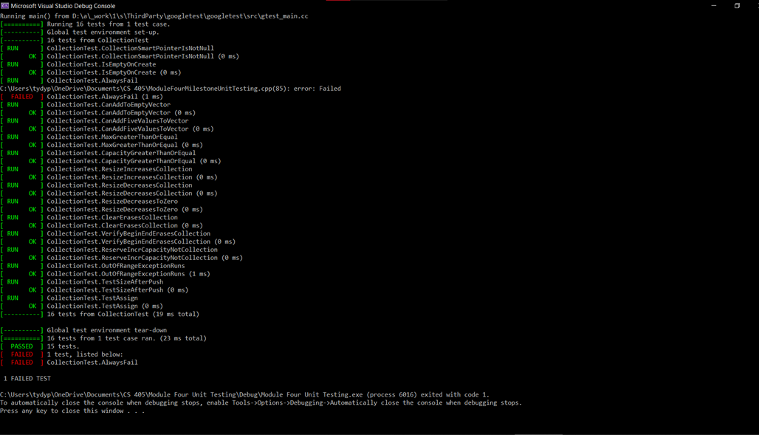
Unit Testing
The use of Unit Testing throughout the development process is important to maintain secure and working code. Like the example unit testing in this illustration showing that the OutOfRangeException test passed.

Slide 9

AUTOMATION SUMMARY

Slide 10
TOOLS
The DevSecOps pipeline is a methodology that has an approach to enforcing a policy that efficiently keeps code secure.
Using things like defense-in-depth and unit testing are various methods to detect vulnerabilities to be able to catch problems early in conjunction with the DevSecOps pipeline.

Slide 11
RISKS AND BENEFITS
There is a lot more risk to waiting and a lot more benefit to acting now. It’s safe to assume that there are going to be vulnerabilities within a system, the best idea is not to wait. This gives the least amount of time for an attack to take place. The best thing to do is address these vulnerabilities on the level of their priority, taking care of them in that order prevents the most major threats from taking place.

Slide 12
RECOMMENDATIONS
Keeping everything simple and keeping up with the security threats is the most important aspect of the system. Technology moves quickly, so there are going to be new and different vulnerabilities in the future that will need to be addressed in order to maintain the security of the system.

Slide 13
CONCLUSIONS
Keeping it simple is an important aspect to keep in mind while coding, making things more complicated can lead to more vulnerabilities, not less.
Practicing Defense in Depth is one of the most important principles of this security policy, having multiple layers of protection is valuable to security.
Having the correct encryption policies with valuable data is important to maintaining the system and its total security.

Slide 14
REFERENCES
What is defense in depth? defined and explained. Fortinet. (n.d.). Retrieved April 16, 2023, from https://www.fortinet.com/resources/cyberglossary/defense-in-depth#:~:text=Defense%20in%20depth%20is%20a,are%20stopped%20along%20the%20way.

